Slide 1
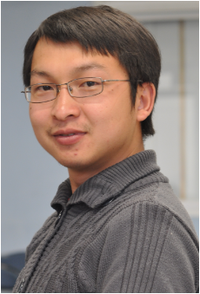
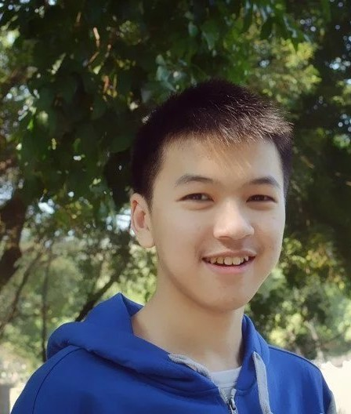
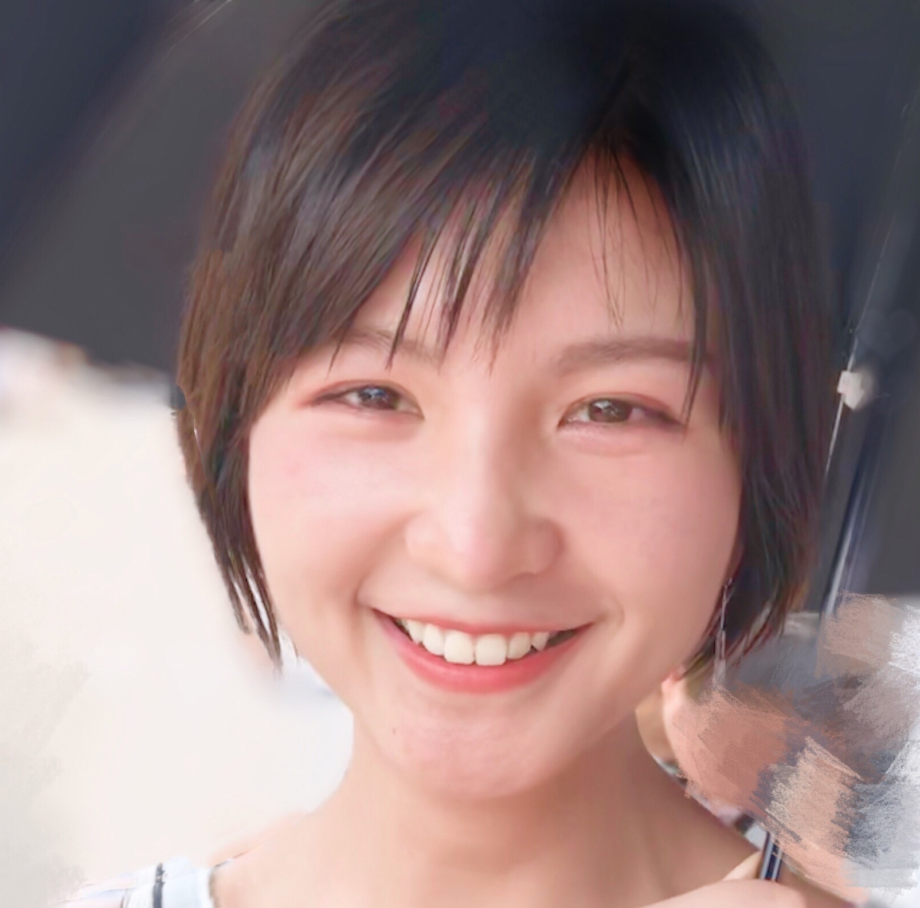
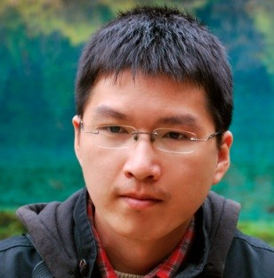


DeepDrawing: A Deep Learning Approach to Graph Drawing
Yong Wang^{1.} Zhihua Jin^{1,4} Qianwen Wang¹ Weiwei Cui^{2.} Tengfei Ma^{3.} Huamin Qu¹
http://yong-wang.org/proj/deepDrawing.html
1
2
3
4
Notes:
Hello, everyone, welcome to my talk today. I am Yong Wang, from HKUST.

Slide 2
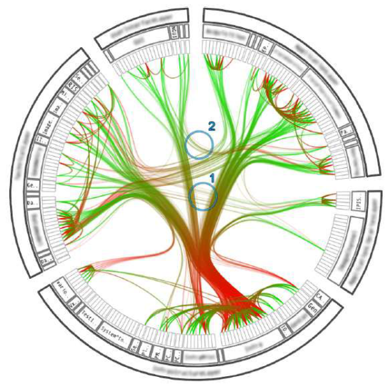
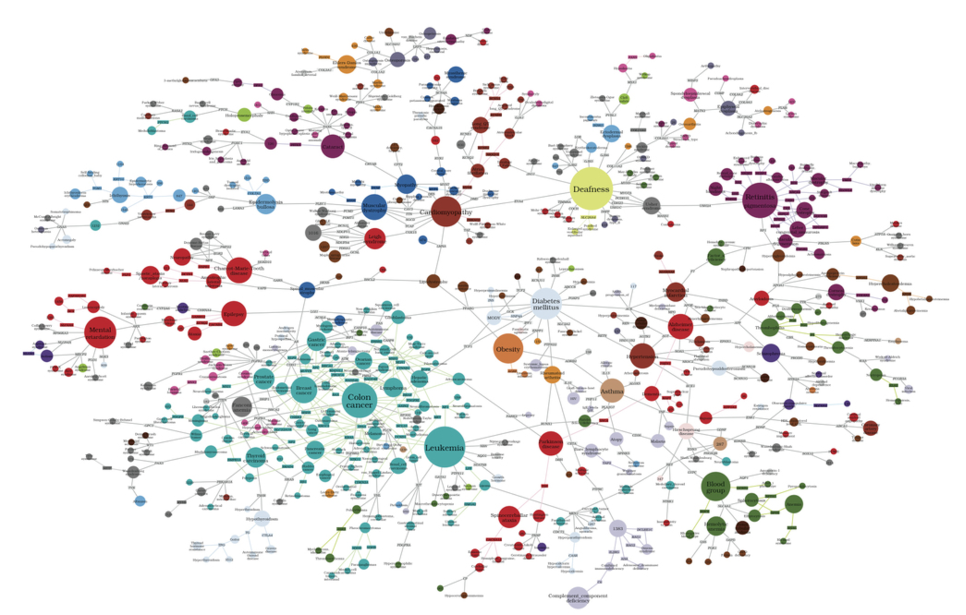
Motivation
Graph drawing has been extensively studied to facilitate the exploration, analysis and presentation of networks!

Slide 3
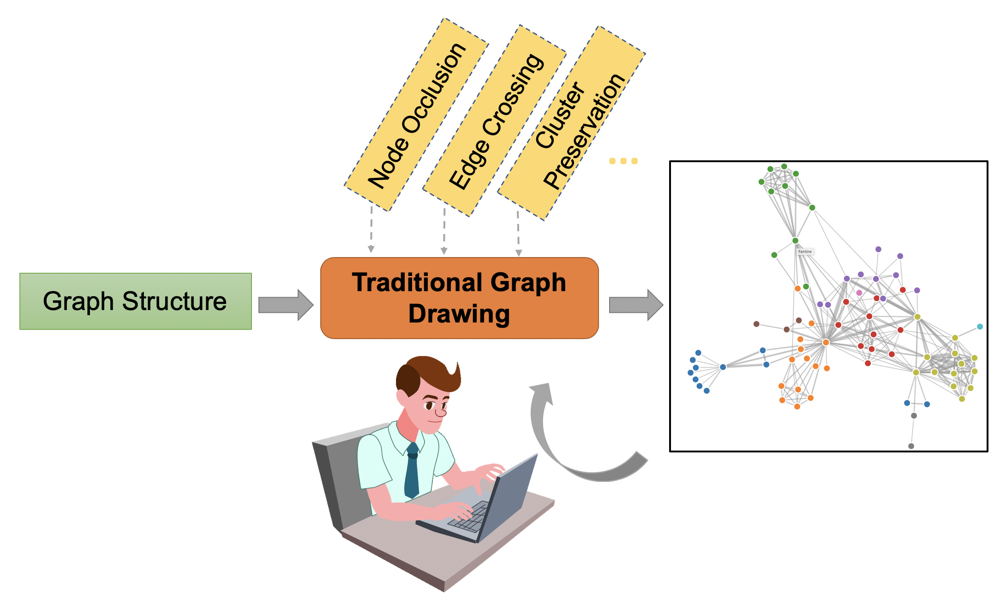
Motivation
Graph drawing has been extensively studied to facilitate the exploration, analysis and presentation of networks!
However, users often need to find a desirable graph layout through trial-and-error:
- Tune different algorithm-specific parameters
- Compare different drawing results
Notes:
However, users often need to find a desirable graph layout through trial and error.
Specifically, users need to Manually tune different …
And compare different drawing results.

Slide 4
Motivation
Graph drawing has been extensively studied to facilitate the exploration, analysis and presentation of networks!
However, users often need to find a desirable graph layout through trial-and-error:
It is time-consuming and not user-friendly, especially for non-expert users!
Notes:
Such a trial and error process is time-consuming and not user friendly, especially for non-expert users.

Slide 5
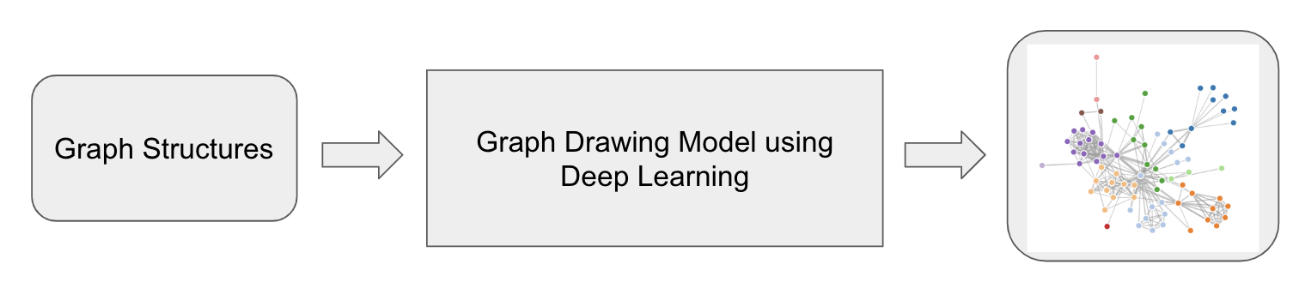
Research Question
Deep learning techniques have shown a powerful capability of modelling the training data and further making predictions in many applications
Can we model graph drawing as a learning and prediction problem and further generate drawings for input graphs directly?

Slide 6
Overall Idea
Training Stage
Graph Drawing Samples
Sample 1
Sample 2
Sample 3
Sample 4
...
Testing Stage
Graph Structure
Deep Learning Based Drawing
Graph Visualizations
Notes:
So an overall idea of using deep learning techniques for graph drawing is: first, given a set of graph drawing samples with desirable visual properties, we train a deep learning model on it.
Once the model is well trained, then given a input graph, the trained deep learning model can be used to predict the layout positions of each node.
This rough idea is quite straightforward, right?
But how to realize such a overall idea is actually very challenging.

Slide 7
Challenges
Model Architecture
Loss Function Design
Training Datasets

Slide 8
Challenges
Model Architecture
- Existing deep learning techniques are mainly applied to the Euclidean data (e.g., images, videos and texts), instead of graphs
- Recent research on Graph Neural Network mainly targets at node classification and link prediction on a single graph, which is much different from graph drawing

Slide 9
Challenges
Model Architecture
Loss Function Design
- How to evaluate whether a drawing for an input graph is ”correct” or not?

Slide 10
Challenges
Model Architecture
Loss Function Design
Training Datasets
- There are no publicly-available high-quality datasets for graph drawing

Slide 11
DeepDrawing
Model Architecture
Model Input
Loss Function Design
Dataset Generation
Notes:
So in this paper, we target at handling the above three challenges and propose a deep learning based approach for graph drawing, which we call it deepdrawing.
Let me introduce our methods in detail from the perspective of model architecture, model input, loss function design and dataset generation.

Slide 12
DeepDrawing – Model Architecture
Major Considerations
The majority of graph neural networks mainly focus on the learning and prediction tasks for a single graph
However, a recent study^{[1]} has shown that RNNs are capable of modelling the structure information of multiple graphs
[1] J. You, R. Ying, X. Ren, W. L. Hamilton, and J. Leskovec. Graphrnn: a deep generative model for graphs. In Proceedings of the 35th International Conference on Machine Learning, 2018.
Notes:
To propose an appropriate model for graph drawing, we extensively surveyed existing graph neural networks and find that the majority of …., which is not suitable for graph Drawing.
However, a recent study from stanford has shown that RNNs has the capability of modeling ….
This gives us a great inspiration.

Slide 13
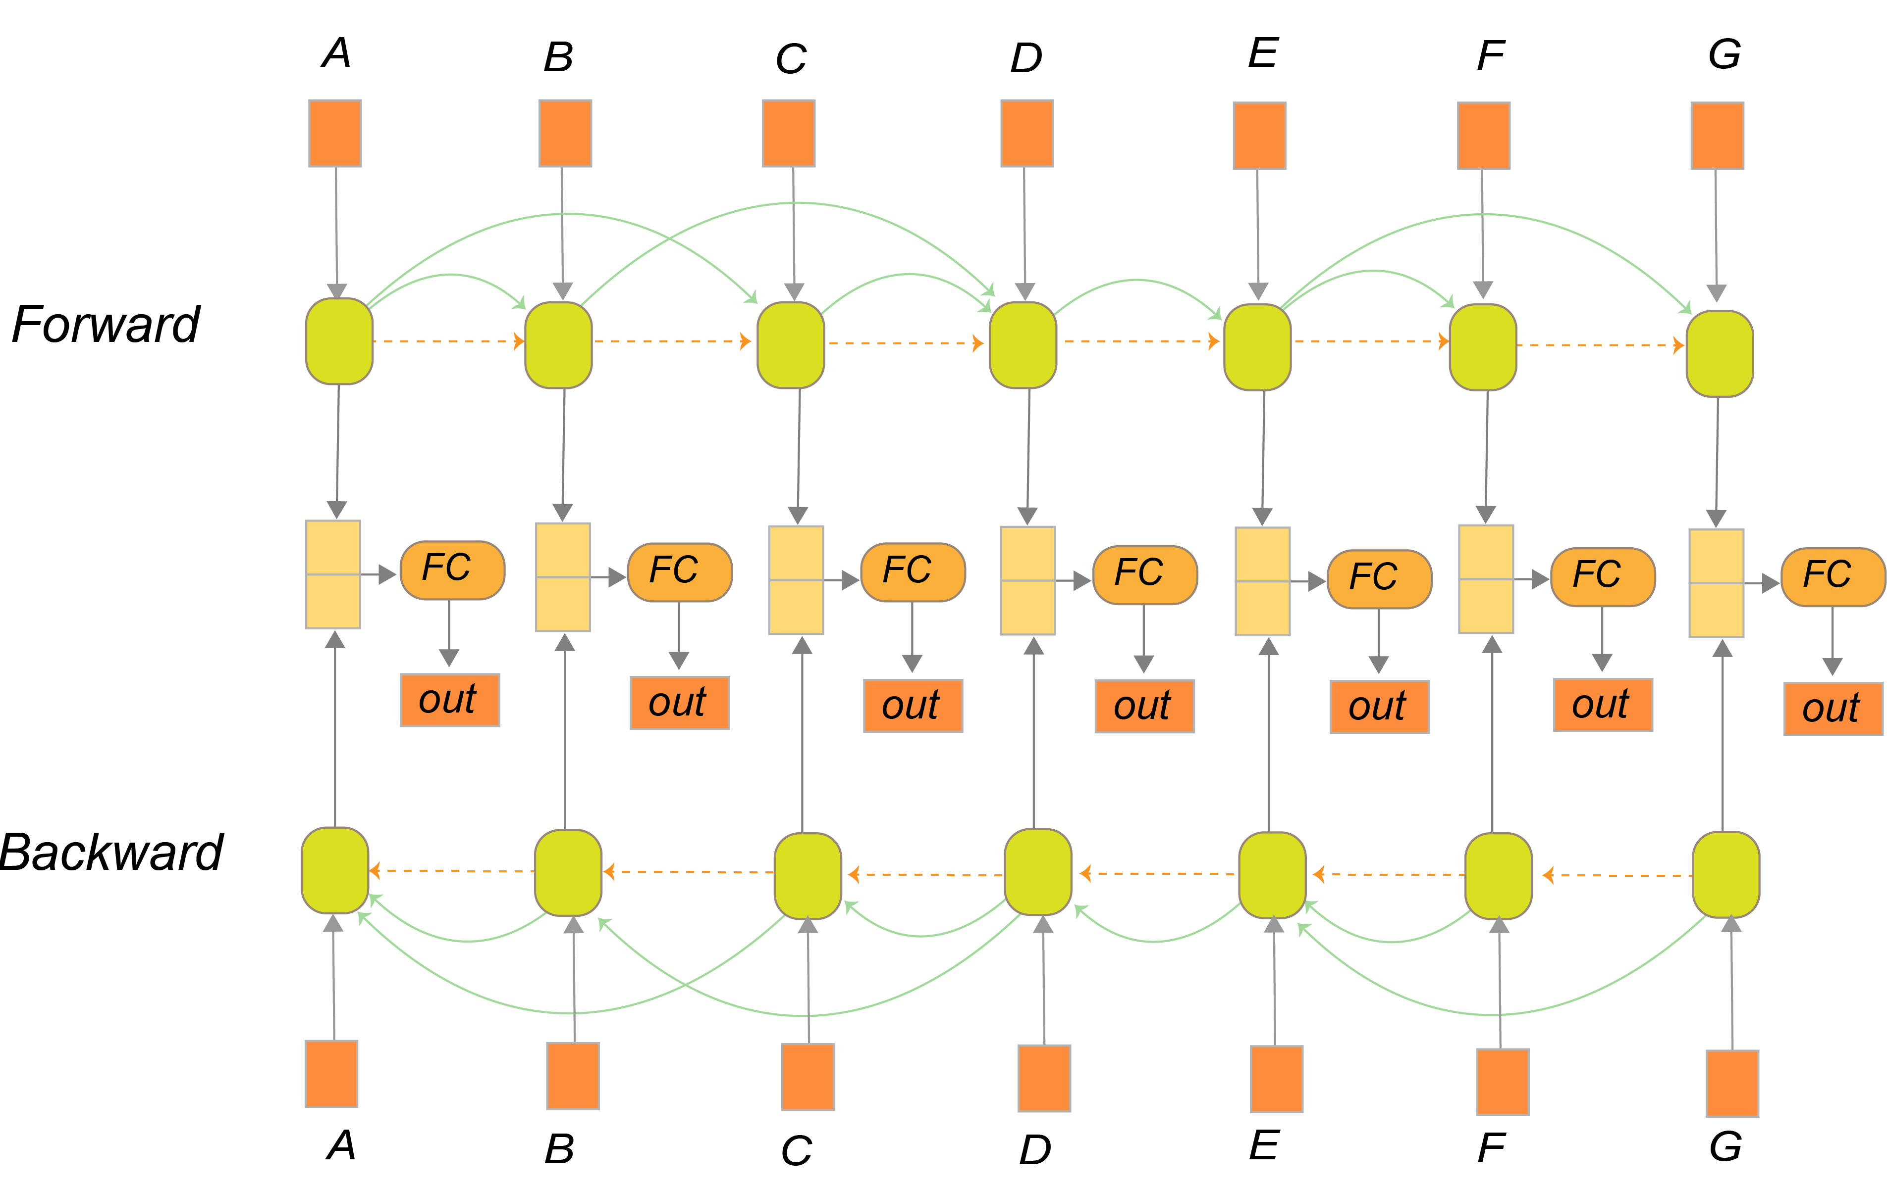
DeepDrawing – Model Architecture
We propose a bi-directional graph-LSTM based model for graph drawing.
Notes:
Inspired by this, we propose a bi-directional graph-LSTM based model for graph drawing.

Slide 14
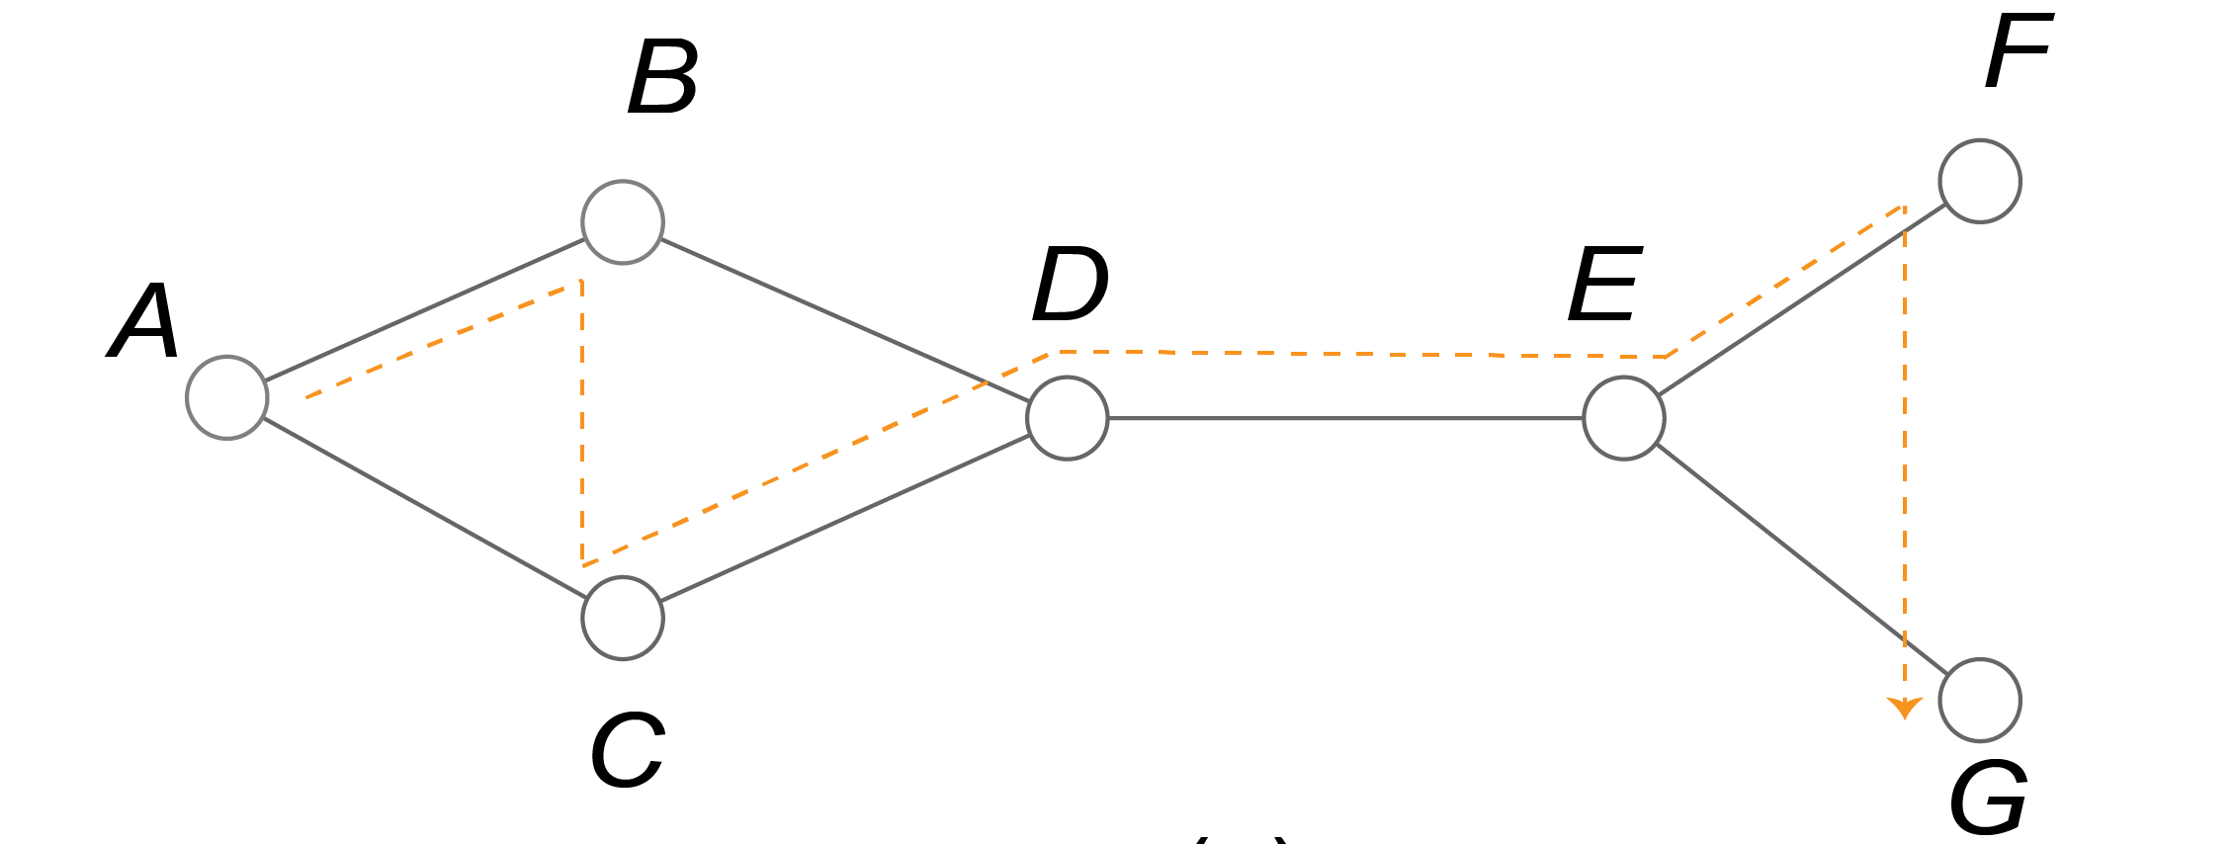
DeepDrawing – Model Architecture
Architecture Details:
BFS-ordering of graph nodes
Notes:
Let me introduce the details of the architecture, basically, a RNN-based model requires an input sequence. So we use BFS to sort the graph nodes and transform it into a BSF-ordered sequence of nodes.

Slide 15
DeepDrawing – Model Architecture
Architecture Details:
BFS-ordering of graph nodes
Fake edges (dotted yellow arrow) and real edges (green arrow)
Notes:
For a LSTM model, the influence of all the prior nodes on subsequent nodes is reflected by the links between adjacent nodes, as shown by the dotted yellow arrows, which we call “fake edges” here.
However, graphs are not a sequence in essence. So we propose further adding the real edges of the graph, as shown by the green arrows, to the LSTM model. It can indicate the influence of all the prior directly-connected nodes on the current node. By such a way, it can delineate more details of the graph.

Slide 16
DeepDrawing – Model Architecture
Architecture Details:
BFS-ordering of graph nodes
Fake edges and real edges
Bi-directional
Notes:
Another important consideration is that: when doing actual graph drawing, the latter nodes in the sequence can also influence the positions of the former nodes. To reflect such a property of graph drawing, we make the whole model architecture bi-directional.

Slide 17
DeepDrawing – Model Architecture
Architecture Details:
BFS-ordering of graph nodes
Fake edges and real edges
Bi-directional
Notes:
Then the inner states of forward and backward directions will be combined to predict the final positions of the graph nodes.

Slide 18
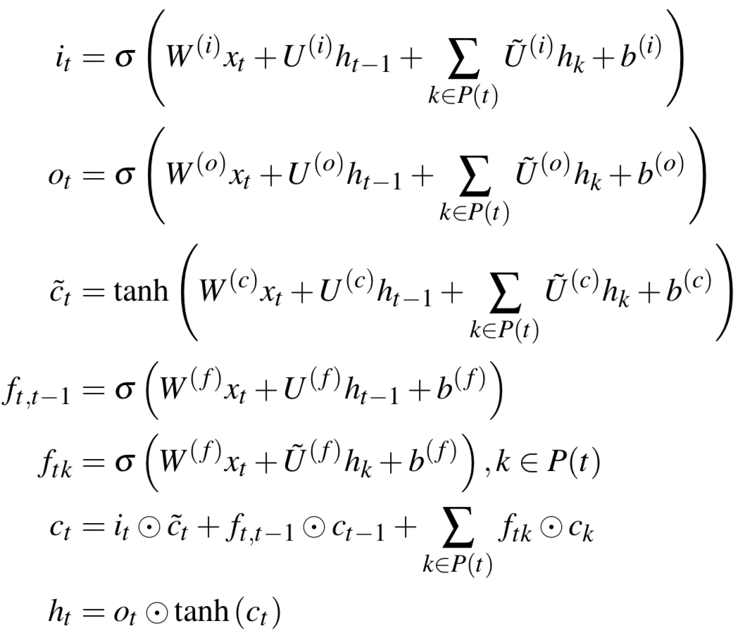
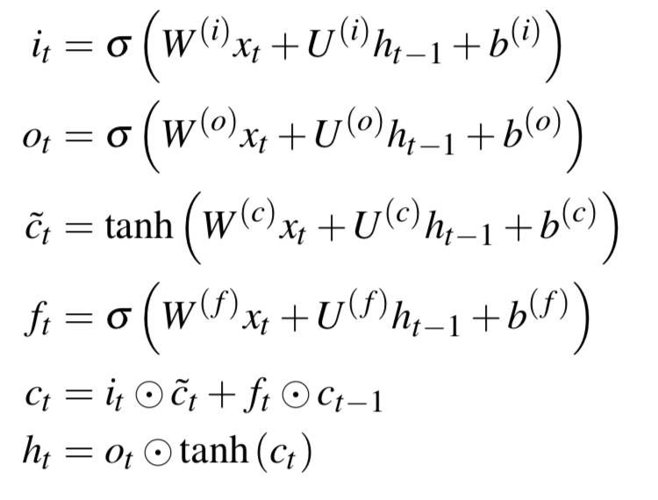
DeepDrawing – Model Architecture
Architecture Details:
Our Model
LSTM
The difference of transition function between general LSTM and our model.
Notes:
If we check the details of the transition function of our model, it is easy to find that compared with the general LSTM model, we mainly further considered the information of the nodes directly connected to the current node in the graph, as highlighted by the dotted red rectangles.

Slide 19
DeepDrawing – Model Input
Node Feature Vector
Natural choice: node embedding
A fixed-length adjacency vector encoding the connection information between the current node and its prior nodes.
They mainly target at single graphs and are not able to be generalized to multiple graphs^{[2]}!
[2] M. Heimann and D. Koutra. On generalizing neural node embedding methods to multi-network problems. In KDD MLG Workshop, 2017.

Slide 20
DeepDrawing – Model Input
Node Ordering
Random ordering
The possible orderings for an input graph can be very large!
BFS ordering
- Avoid exhaustively going through all possible node permutations
- There is an upper bound for the possible connection between the current node and its prior furthest nodes along the BFS sequence^{[1]}!
[1] J. You, R. Ying, X. Ren, W. L. Hamilton, and J. Leskovec. Graphrnn: a deep generative model for graphs. In Proceedings of the 35th International Conference on Machine Learning, 2018.
Notes:
So, the node ordering is a critical issue here. As mentioned above, we use BFS-ordering to sort the nodes. So Why not directly using the random ordering of graph nodes? the reasons are two-folds. First, if we use random ordering, the possible ordering …. Can be very large. If we use bfs-ordering, it can avoid …., reducing the searching space for the model training.
Second, it has been proved that there is an upper bound ….. This means that we can empirically set a reasonable small length for the feature vector.

Slide 21
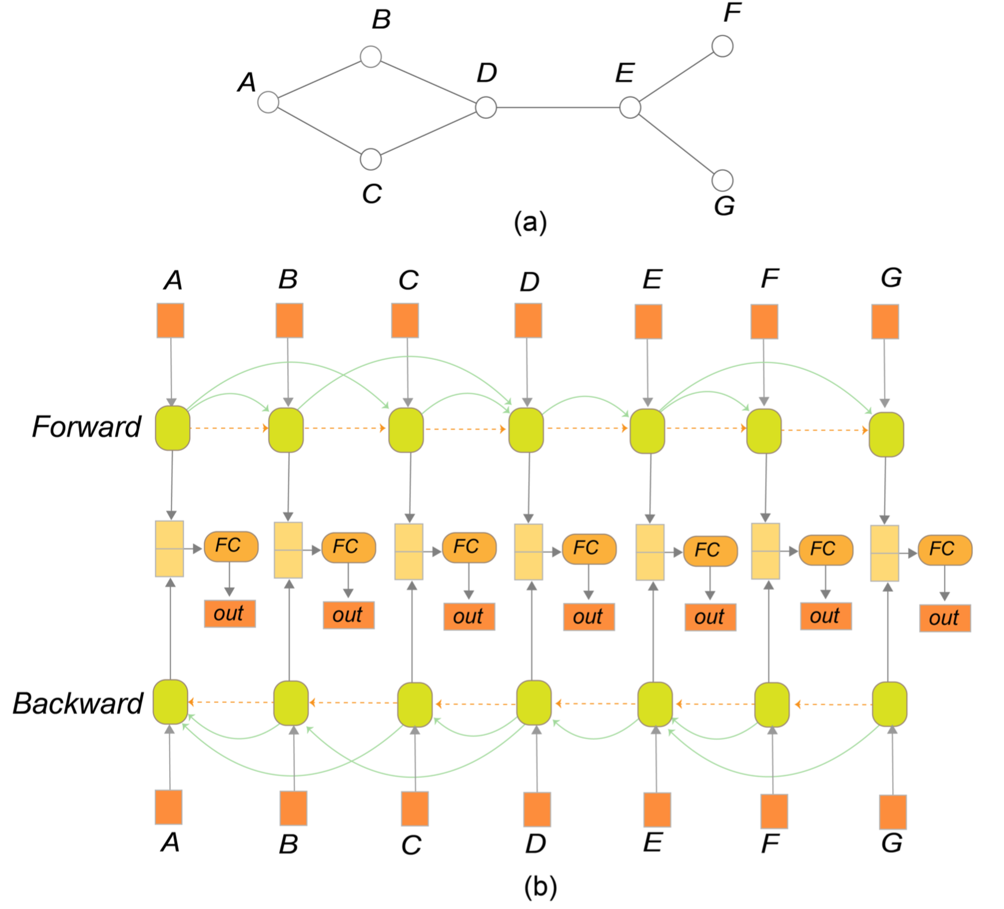
DeepDrawing – Model Input
Notes:
Therefore, we finally got this graph-LSTM based model architechure.

Slide 22
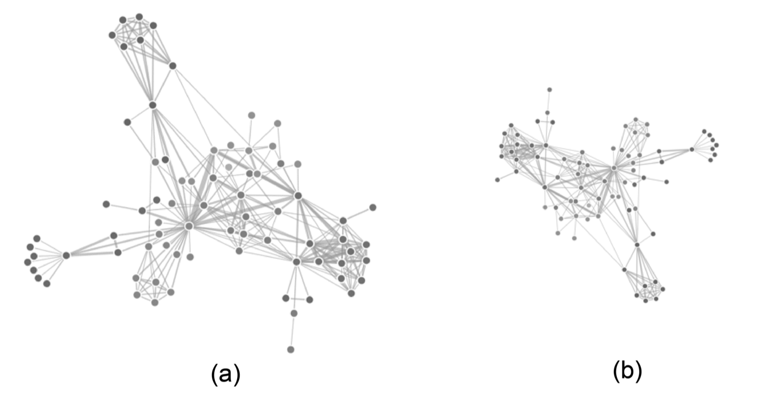
DeepDrawing – Loss Function Design
Design Considerations
Make the predicted drawings as similar as possible to the drawings of ground-truth
The function should be invariant to translation, rotation and scaling
Notes:
The third important aspect of our approach is the loss function design. The overall requirement for a good loss function is that the drawings predicted by the deep learning model should be similar to the drawings of the ground-truth.
Also, it should be invariant to …. For example, the following two layouts look significantly different at first glance. But they are actually the same layout, layout b can simply be gained by translating, rotating and scaling Layout a. A good loss function should be able to recognize this.

Slide 23
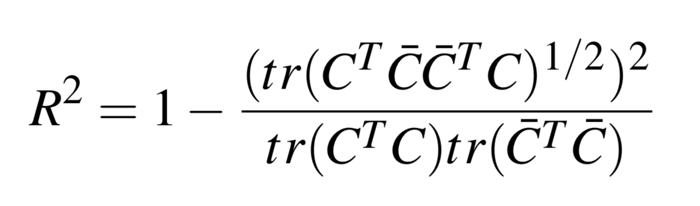
DeepDrawing – Loss Function Design
Procrustes Statistic
It is transformation-invariant
It is between 0 and 1
Zero means the drawings are exactly the same; while one means they are totally different
Notes:
So we propose using Procrustes statistic as the loss function. and its value is …

Slide 24
DeepDrawing – Dataset Generation
We generate:
Graph data: grid graphs, star graphs, clustered general graphs
Graph drawing data: grid layout, star layout, ForceAtlas2, PivotMDS
- We manually tune the parameters of the drawing algorithms

Slide 25
Evaluations
We extensively evaluated the proposed approach:
Qualitative and quantitative evaluations
Comparison with the graph truth drawings and those by the baseline model (a 4-layer Bi-LSTM model)
Notes:
We extensively evaluated the proposed approach by comparing it with the ground truth drawings and the drawings by a 4-layer Bi-LSTM baseline model through both qualitative evaluations and quantitative evaluations.

Slide 26
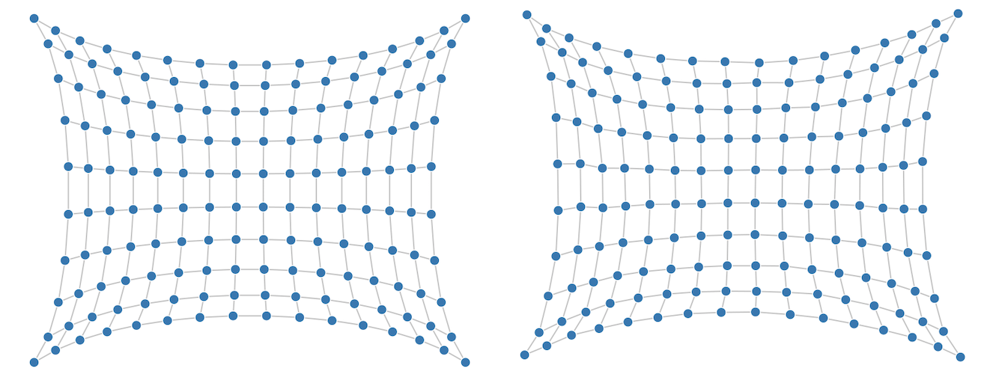
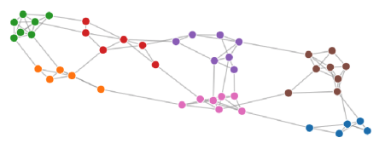
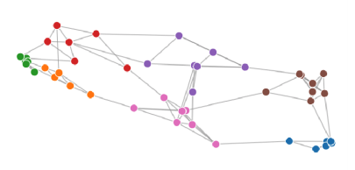
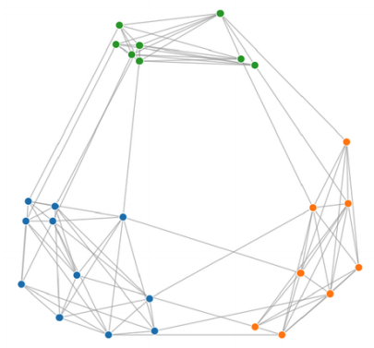
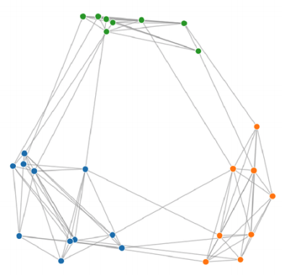
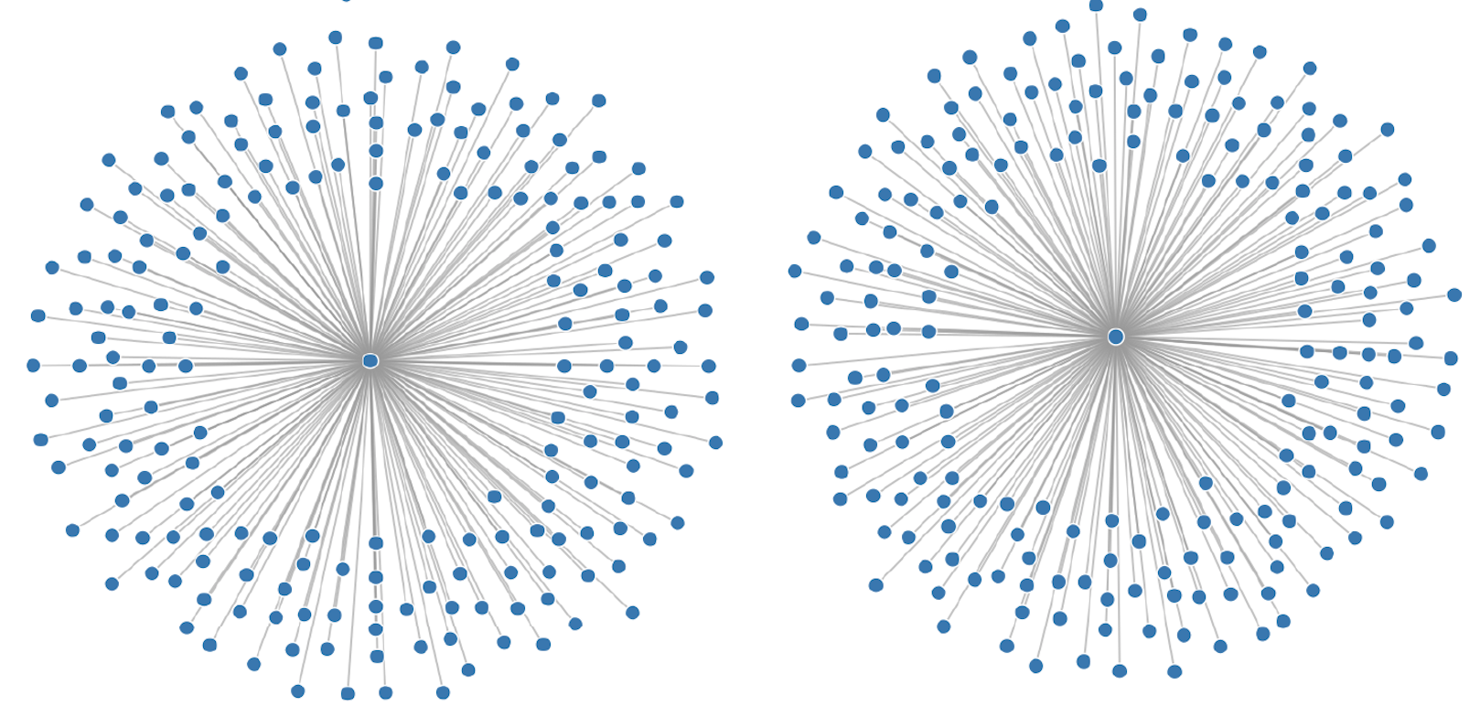
Evaluations – Qualitative Evaluation
Ground-Truth
Our Approach
Ground-Truth
Our Approach
Notes:
For the qualitative evaluation, It shows that the drawings by our approach is quite similar to the ground truth drawings.

Slide 27
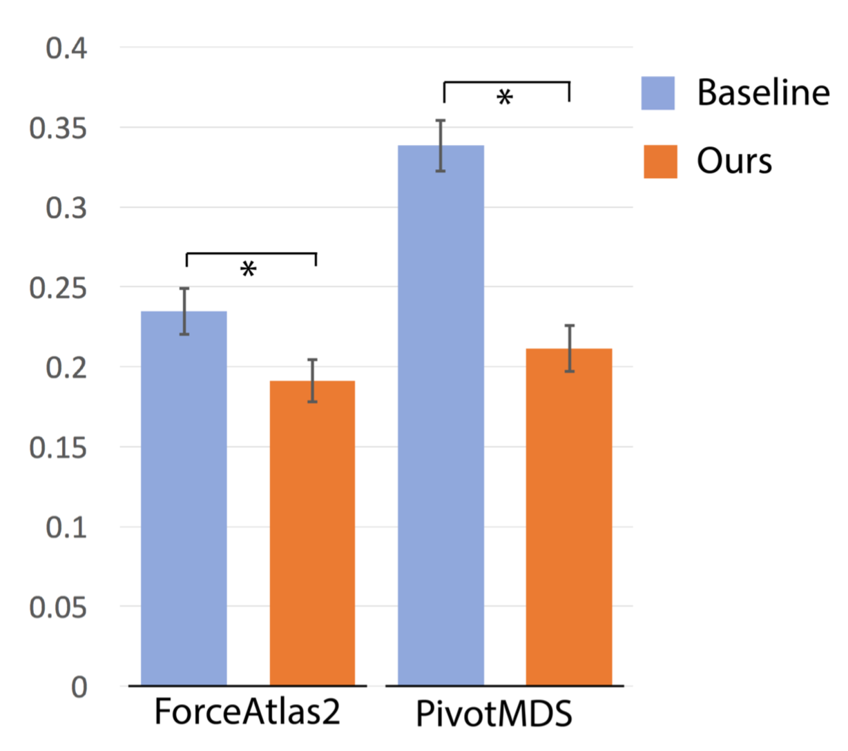
Evaluations – Quantitative Evaluation
Procrustes Statistic-based similarity:
Our approach is significantly better than the baseline model

Slide 28
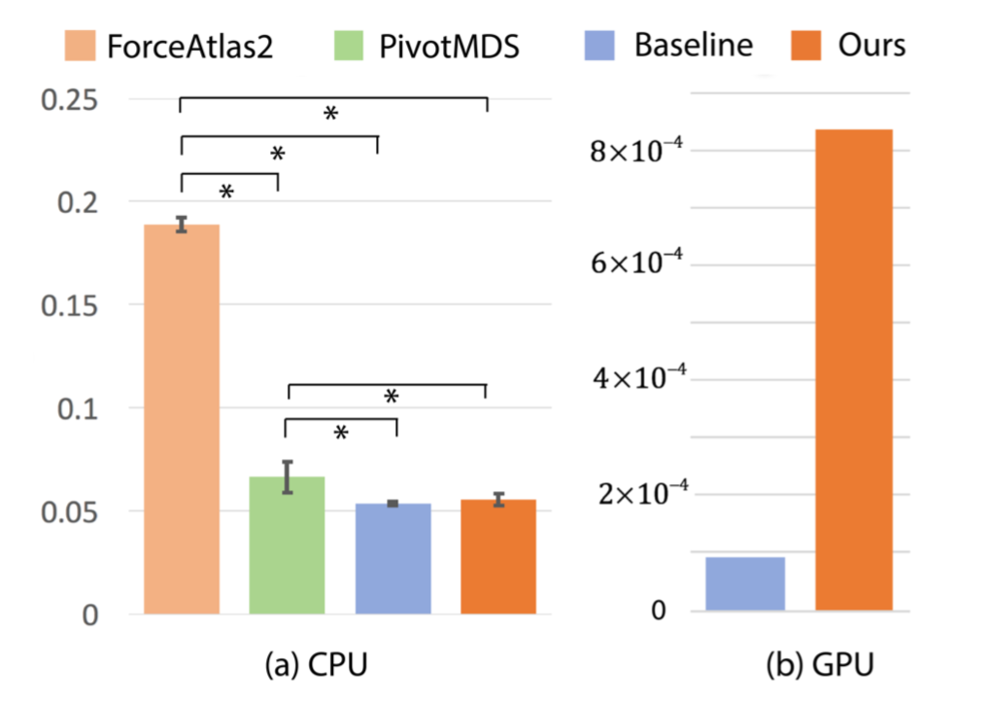
Evaluations – Quantitative Evaluation
Running Speed
CPU: Both our approach and the baseline model is faster than the traditional graph drawing methods
GPU: Our approach is slower than the baseline model on GPU, though it has 80% less parameters
Notes:
We further evaluated the running speed of our approach on both CPU and GPU modes.
When running on CPU, both ... and the ... is ....
When running on GPU, our .... One possible explanation is that the 4 layer Bi-LSTM model is directly implemented based on the pytorch LSTM model, which has been extensively optimized by using cudnn.

Slide 29
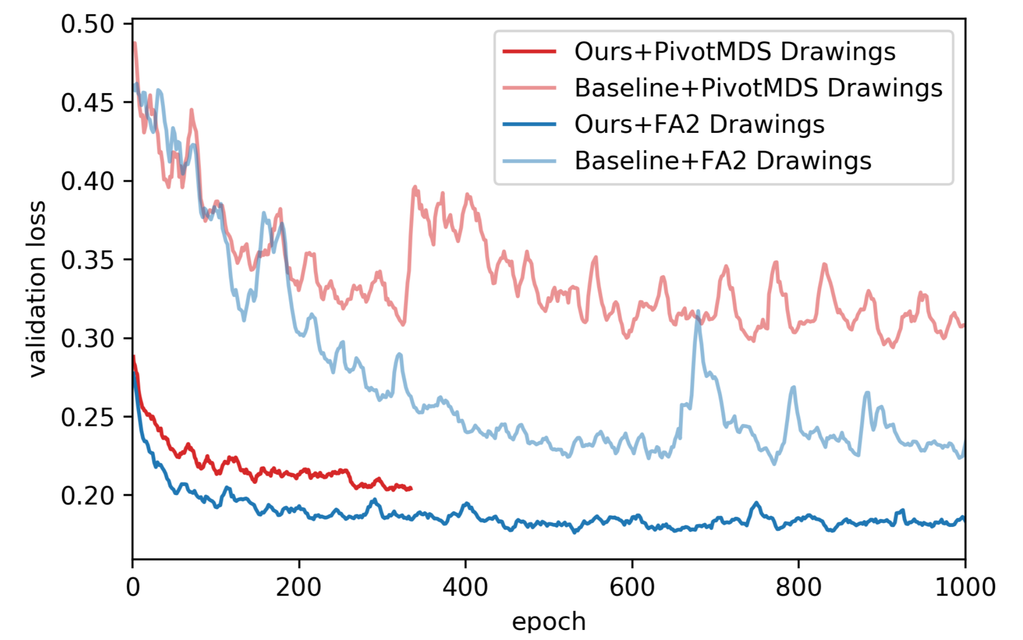
Evaluations – Quantitative Evaluation
Training Convergence Comparison
Our approach can converge
faster than the 4 layer Bi-LSTM in
terms of #Epochs.
Notes:
We also compare the training convergence speed in terms of the number of training epochs.
The right figure shows that our approach can converge much faster than the 4 layer Bi-LSTM model.

Slide 30
Limitations
Lack Interpretability
Our current evaluations mainly focus on small graphs with 20 to 50 nodes
The performance of DeepDrawing has a dependence on the input node ordering and the structure similarity with the training graphs
Notes:
Despite the good experiment results above, Our approach is not without limitations.

Slide 31
Take Home Message
We propose a graph-LSTM based approach to graph drawing and investigate its effectiveness on small graphs
It is worth further exploration in terms of good interpretability and better prediction performance on large graphs
More details: code, video and slides are(or will be) accessible at:
http://yong-wang.org/proj/deepDrawing.html
Notes:
In summary,

Slide 32
DeepDrawing: A Deep Learning Approach to Graph Drawing
Yong Wang^{1.} Zhihua Jin^{1,4.} Qianwen Wang¹ Weiwei Cui^{2.} Tengfei Ma^{3.} Huamin Qu¹
http://yong-wang.org/proj/deepDrawing.html
1
2
3
4

